Slide 1
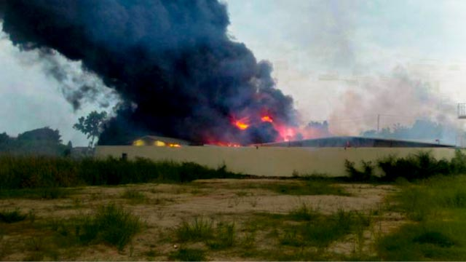
Class 1:
Why are these buildings on fire?
Cryptocurrency Café
cs4501 Spring 2015
David Evans
University of Virginia
Fire at mining facility in Thailand, 14 Oct 2014
Photo credit: www.thairath.co.th

Slide 2
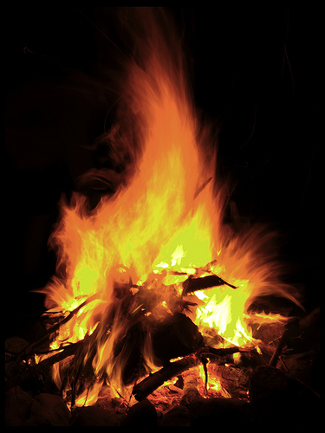
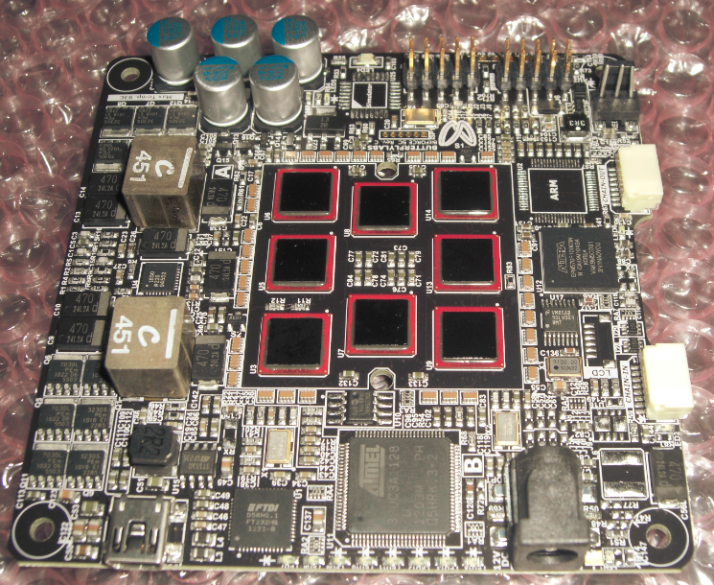
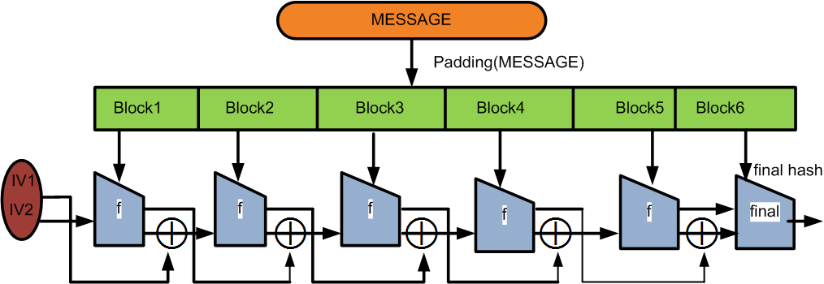
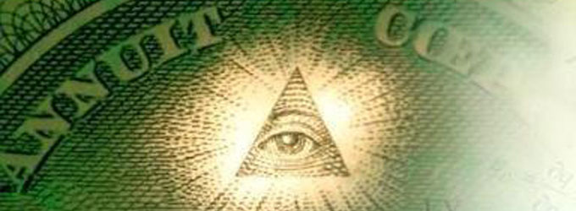
Theory of Computation
Government
Algorithms
Distributed Systems
Physics
Computer Architecture
Cryptography
Economics

Slide 3
Plan for Today
Currency
Course Overview
Bitcoin Introduction (time permitting)

Slide 4
What Makes a “Good” Currency?

Slide 6
What is Currency?

Slide 8
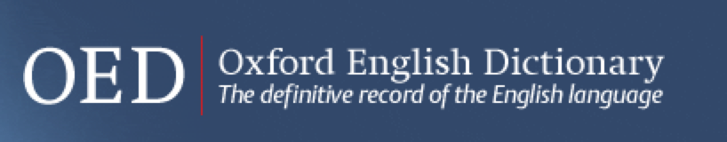
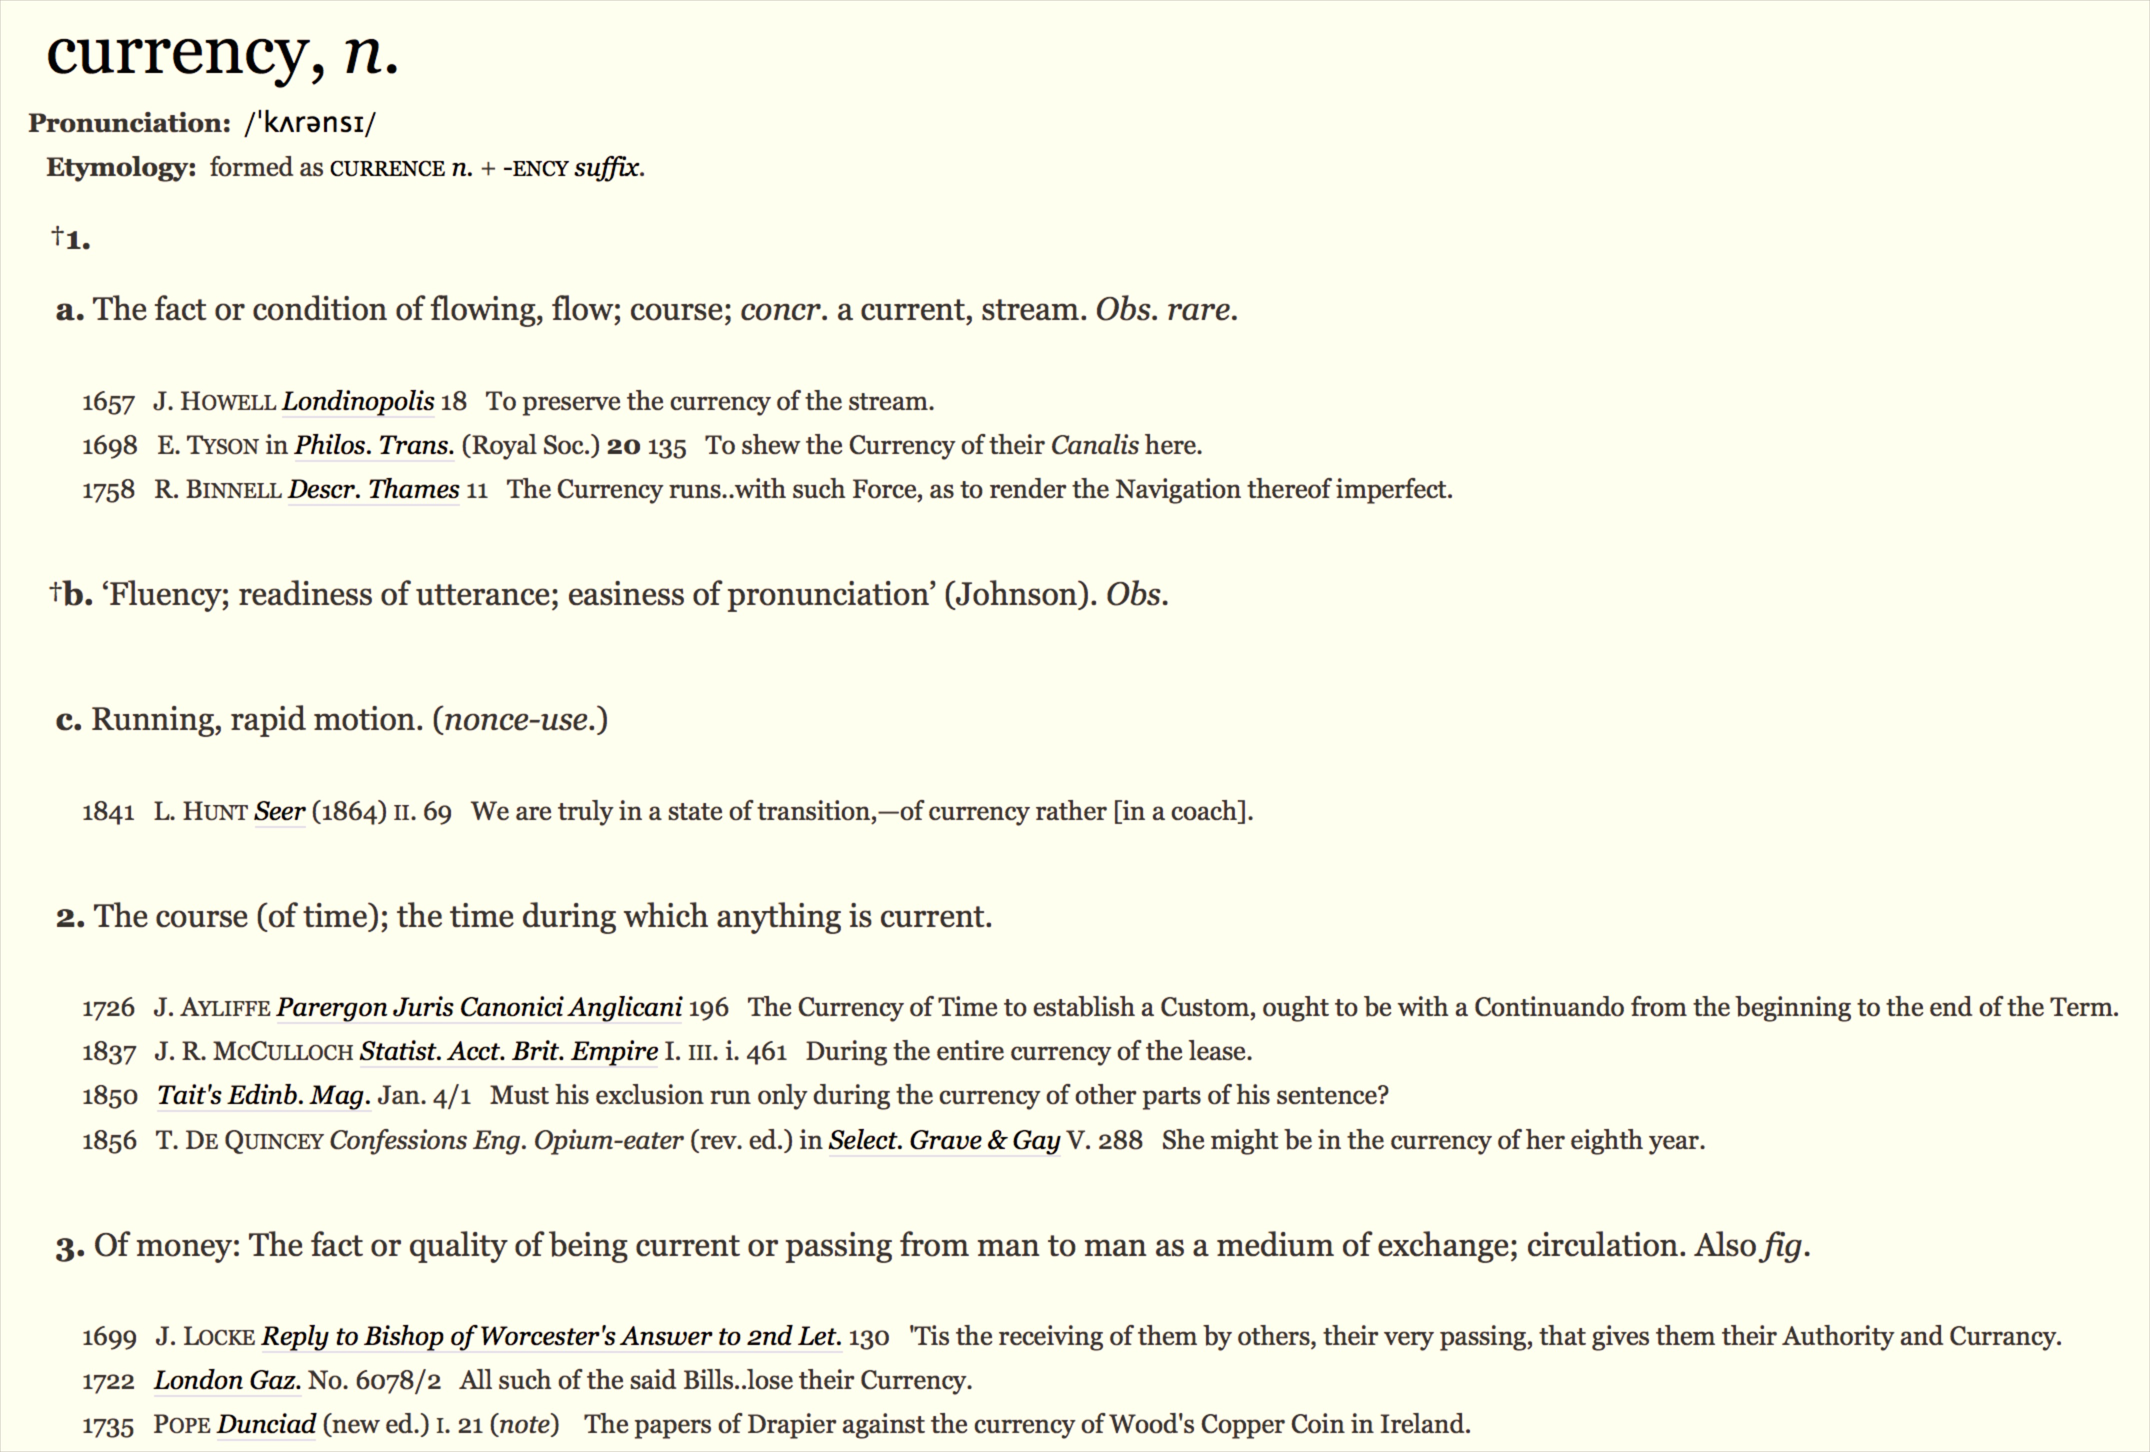

Slide 9
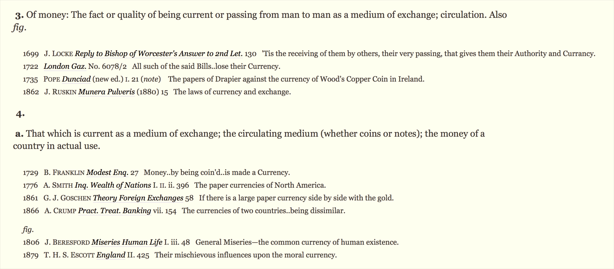

Slide 10
What Makes a “Good” Currency?

Slide 13
Possible Currency Desiderata
Universally Recognized (everyone accepts it)
Stable (value doesn't change)
Scarce (limited supply, difficult to duplicate)
Transferable (easy and inexpensive to exchange)
Persistent (can't be easily destroyed)
Centralized (authority controls money supply and integrity)
Untraceable (cannot trace through transactions)
Anonymous (cannot tell who is involved in a transaction)
Divisible (can subdivide into independent pieces)

Slide 14
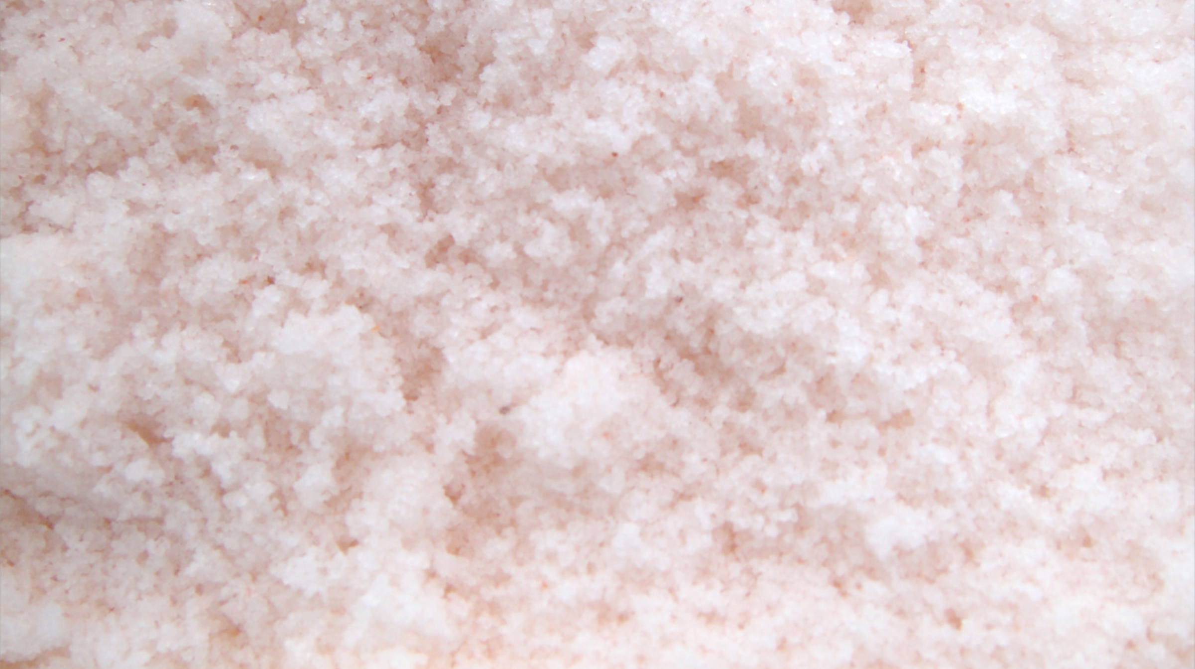
What was the first currency?

Slide 15
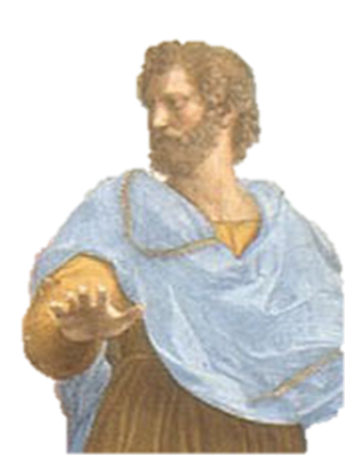
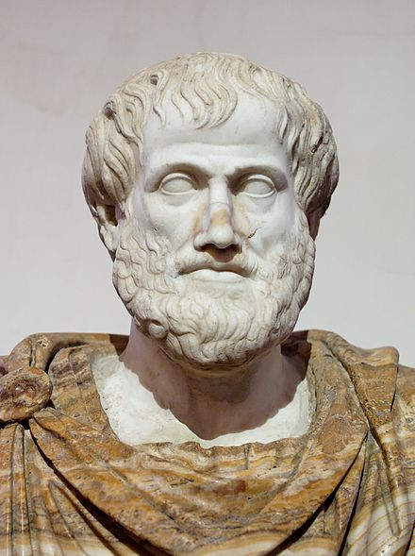

Slide 16
Aristotle’s Politics
around 350 BCE

Slide 17
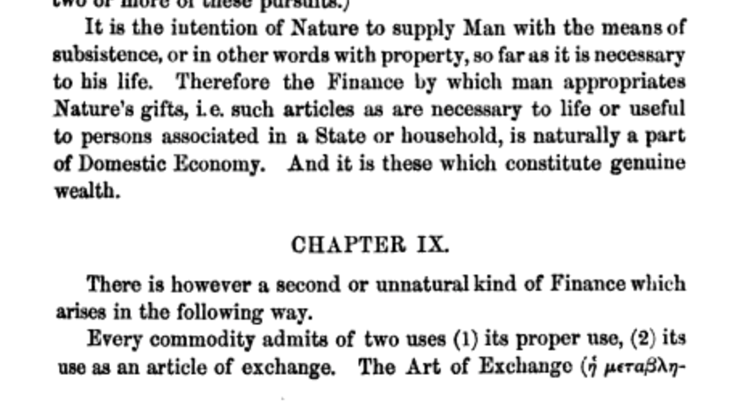
Aristotle’s Politics 350 BCE

Slide 18
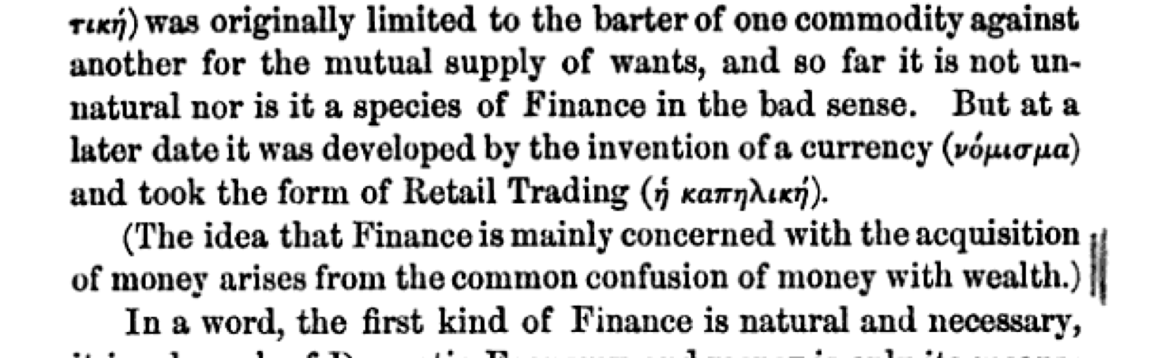
Aristotle’s Politics 350 BCE

Slide 19
How well does salt work as a currency?

Slide 21
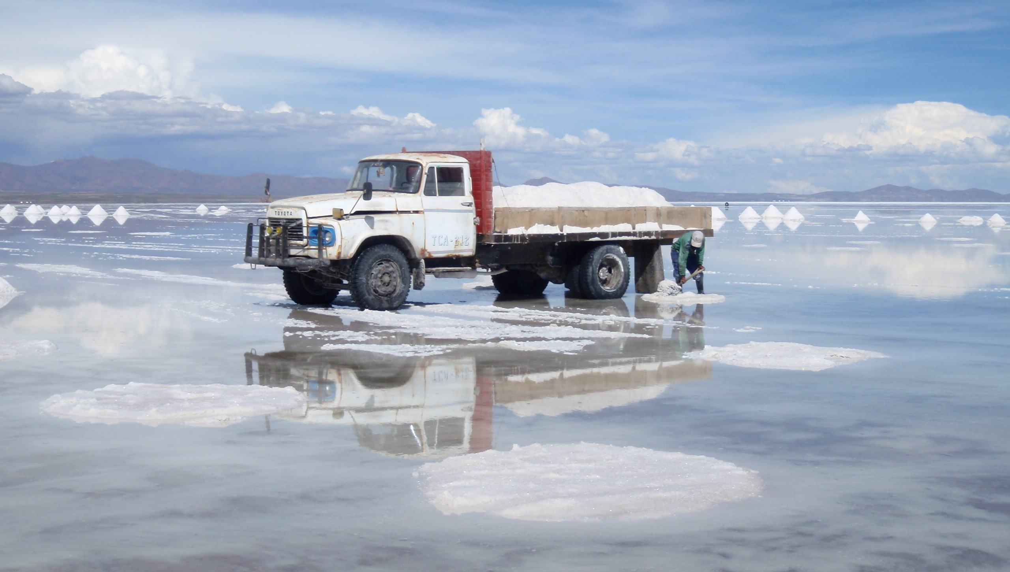
Salt Mining in Bolivia
http://solvingforzero.com/?p=804

Slide 22
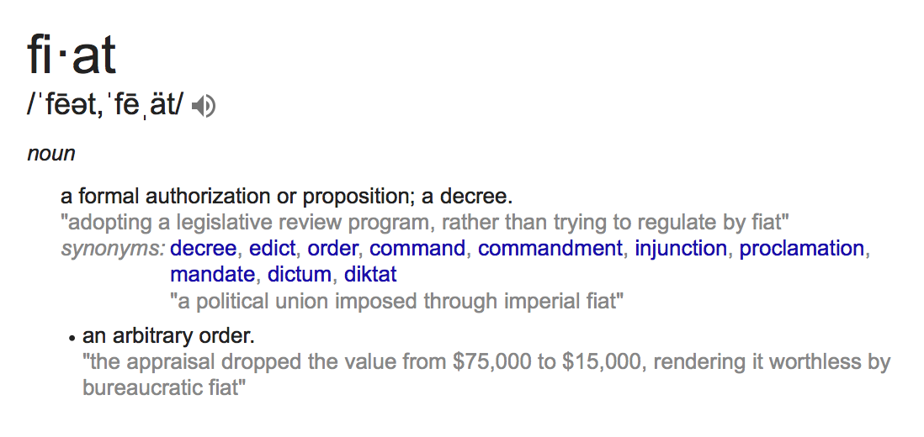
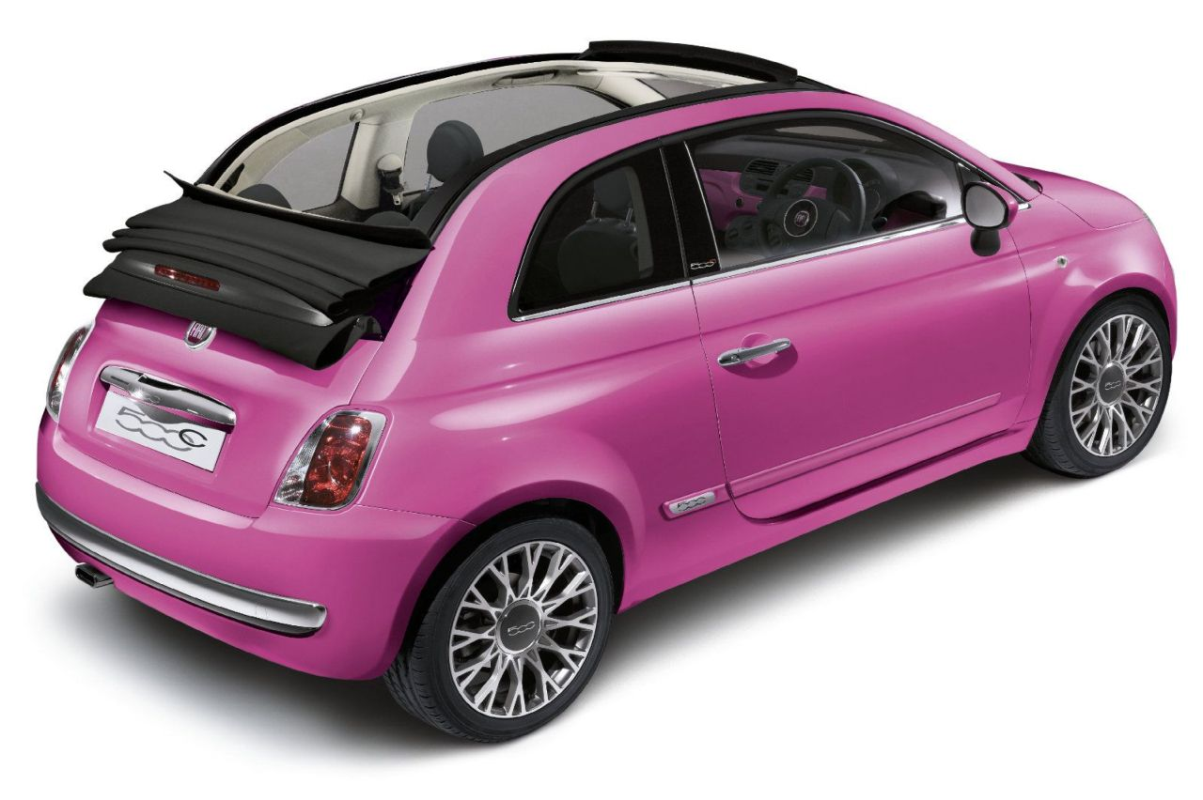
Fiat Currency

Slide 23
Requirements for Fiat Currency

Slide 24
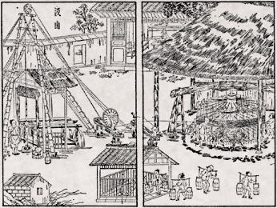
What about salt?

Slide 25
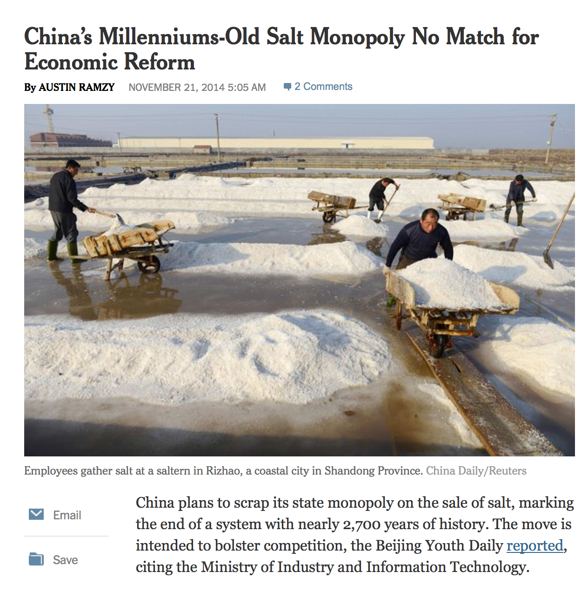
Salt Currency in China? 300 BCE – 2015?

Slide 26
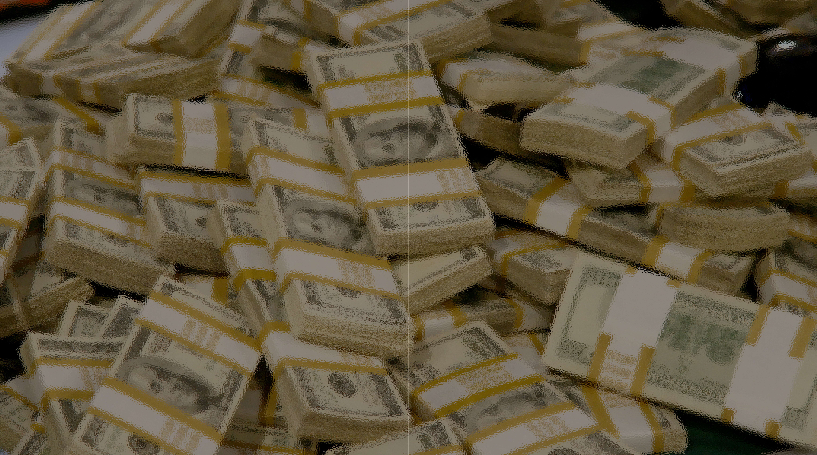
Are US Dollars a good currency?

Slide 28
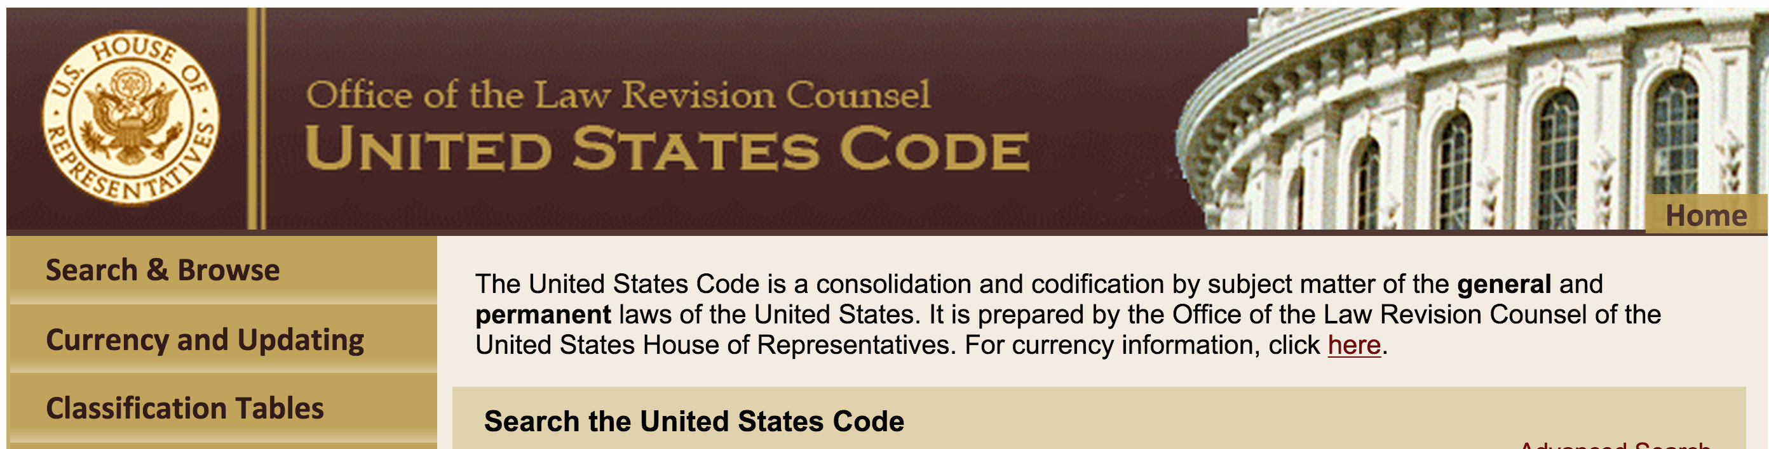

Slide 29
§331. Mutilation, diminution, and falsification of coins
Whoever fraudulently alters, defaces, mutilates, impairs, diminishes, falsifies, scales, or lightens any of the coins coined at the mints of the United States, or any foreign coins which are by law made current or are in actual use or circulation as money within the United States; or
Whoever fraudulently possesses, passes, utters, publishes, or sells, or attempts to pass, utter, publish, or sell, or brings into the United States, any such coin, knowing the same to be altered, defaced, mutilated, impaired, diminished, falsified, scaled, or lightened—
Shall be fined under this title or imprisoned not more than five years, or both.

Slide 30
§333. Mutilation of national bank obligations
Whoever mutilates, cuts, defaces, disfigures, or perforates, or unites or cements together, or does any other thing to any bank bill, draft, note, or other evidence of debt issued by any national banking association, or Federal Reserve bank, or the Federal Reserve System, with intent to render such bank bill, draft, note, or other evidence of debt unfit to be reissued, shall be fined under this title or imprisoned not more than six months, or both.
§331. Mutilation, diminution, and falsification of coins
Whoever fraudulently alters, defaces, mutilates, impairs, diminishes, falsifies, scales, or lightens any of the coins coined at the mints of the United States, or any foreign coins which are by law made current or are in actual use or circulation as money within the United States; or
Whoever fraudulently possesses, passes, utters, publishes, or sells, or attempts to pass, utter, publish, or sell, or brings into the United States, any such coin, knowing the same to be altered, defaced, mutilated, impaired, diminished, falsified, scaled, or lightened—
Shall be fined under this title or imprisoned not more than five years, or both.

Slide 31
§336. Issuance of circulating obligations of less than $1
Whoever makes, issues, circulates, or pays out any note, check, memorandum, token, or other obligation for a less sum than $1, intended to circulate as money or to be received or used in lieu of lawful money of the United States, shall be fined under this title or imprisoned not more than six months, or both.
Is bitcoin illegal?

Slide 32
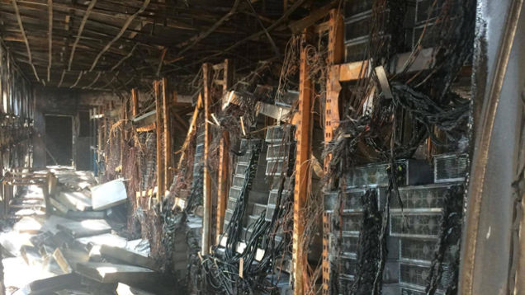
Course Overview

Slide 33
My Main Goals
Understand bitcoin: a decentralized digital currency
Learn computer science: cryptocurrency as a vehicle for many interesting topics – cryptography, theory, architecture, protocols, software security
Learn other subjects: cryptocurrency connects with economics, history, politics, law, criminology, etc.
Do something worthwhile: everyone should produce interesting things of external lasting value
This is not a required course.
If your goals are not well-aligned with mine, take a different class!

Slide 34
What is my goal for lectures?
Convey some complex technical ideas
Teach you what you need to know for projects
Avoid being fired
Keep most of you awake for 75 minutes
Get you to laugh at dumb jokes

Slide 35
What is my goal for lectures?
Convey some complex technical ideas
Teach you what you need to know for projects
Avoid being fired
Keep most of you awake for 75 minutes
Get you to laugh at dumb jokes
Lectures are a horrible medium for learning complex ideas.
Better to read wikipedia.

Slide 36
What is my goal for lectures?
Convey some complex technical ideas
Teach you what you need to know for projects
Avoid being fired
Keep most of you awake for 75 minutes
Get you to laugh at dumb jokes
Lectures are a horrible medium for learning complex ideas.
Better to read wikipedia.
The point of the projects is to teach things I want you to learn (mostly by suggesting things to learn on your own).

Slide 37
What is my goal for lectures?
Convey some complex technical ideas
Teach you what you need to know for projects
Avoid being fired
Keep most of you awake for 75 minutes
Get you to laugh at dumb jokes
Lectures are a horrible medium for learning complex ideas.
Better to read wikipedia.
The point of the projects is to teach things I want you to learn (mostly by suggesting things to learn on your own).
I have tenure already

Slide 38
What is my goal for lectures?
Convey some complex technical ideas
Teach you what you need to know for projects
Avoid being fired
Keep most of you awake for 75 minutes
Get you to laugh at dumb jokes
Lectures are a horrible medium for learning complex ideas.
Better to read wikipedia.
The point of the projects is to teach things I want you to learn (mostly by suggesting things to learn on your own).
I have tenure already
You probably should be getting more sleep!

Slide 39
What is my goal for lectures?
Convey some complex technical ideas
Teach you what you need to know for projects
Avoid being fired
Keep most of you awake for 75 minutes
Get you to laugh at dumb jokes
Lectures are a horrible medium for learning complex ideas.
Better to read wikipedia.
The point of the projects is to teach things I want you to learn (mostly by suggesting things to learn on your own).
I have tenure already
You probably should be getting more sleep!
Monty Python is funnier
(unless you are Kevin Redmon)

Slide 40
My Real Goal for Lectures
Provide context and meaning for the things you have or will later learn on your own.
Support a vibrant, productive, and enjoyable community of scholars!

Slide 41
What I Expect from You
Be Honorable
Most assignments allow flexible collaborations and using any resources; a few will not
Be Respectful of your classmates and others
Follow the HackerSchool social rules
Read the syllabus expectations

Slide 42
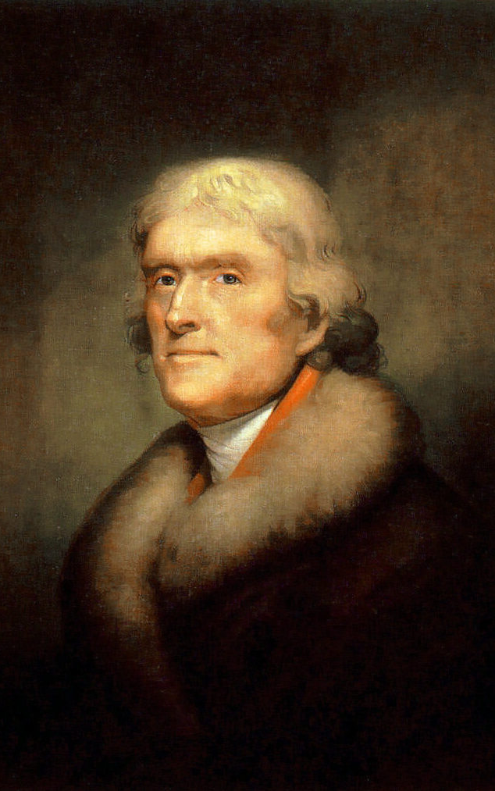
What Mr. Jefferson Wants

Slide 43
What Mr. Jefferson Wants
“We wish to establish in the upper country of Virginia, and more centrally for the State, a University on a plan so broad and liberal and modern, as to be worth patronizing with the public support, and be a temptation to the youth of other States to come and drink…”
TJ’s letter to Joseph Priestly, 1800

Slide 44
Note: this does not mean he wants you to be lazy:
:
Thomas Jefferson enrolled in the College of William and Mary on March 25, 1760, at the age of 16…
By the time he came to Williamsburg, the young scholar was proficient in the classics and able to read Greek and Latin authors in the original… He was instructed in natural philosophy (physics, metaphysics, and mathematics) and moral philosophy (rhetoric, logic, and ethics). A keen and diligent student, he displayed an avid curiosity in all fields and, according to family tradition, he frequently studied fifteen hours a day.
http://www.wm.edu/about/history/tjcollege/tjcollegelife/

Slide 45
Course Format
Now until Spring Break (9 March)
Technical and non-technical understanding of cryptocurrency
Regular short problem sets (readings, questions, short technical problems)
Three structured projects: bitcoin wallet, bitcoin miner, blockchain analysis

Slide 46
After Spring Break
Student-led presentations
Groups of 2-3 students
Selected topic, research papers
Open-ended final project
Something interesting and relevant
Technical, semi-technical, or non-technical

Slide 47
Questions about Course

Slide 48
How can we own something digital?

Slide 50
How can something digital be scarce?

Slide 52
Charge
bitcoin-class.org:
Five TODOs
before 11:59pm tomorrow!

